Slide 1
Public Key Algorithm
The concept of public-key cryptography was invented by Whitfield Diffie and Martin Hellman, and independently by Ralph Merkle.
Their contribution to cryptography was the notion that keys could come in pairs—an encryption key and a decryption key—and that it could be infeasible to generate one key from the other.
Since 1976, numerous public-key cryptography algorithms have been proposed. Many of these are insecure. Of those still considered secure, many are impractical.
Either they have too large a key or the ciphertext is much larger than the plaintext.

Slide 2
Only a few algorithms are both secure and practical. These algorithms are generally based on one of the hard problems .
Of these secure and practical public-key algorithms, some are only suitable for key distribution.
Others are suitable for encryption (and by extension for
key distribution). Still others are only useful for digital signatures.
Only three algorithms work well for both encryption and digital signatures: RSA, ElGamal, and Rabin.
All of these algorithms are slow.
They encrypt and decrypt data much more slowly than symmetric algorithms; usually that’s too slow to support bulk data encryption.

Slide 3
RSA
Named after the three inventors—Ron Rivest, Adi Shamir, and Leonard Adleman—it has since withstood years of extensive cryptanalysis.
Although the cryptanalysis neither proved nor disproved RSA’s security, it does suggest a confidence level in the algorithm.
RSA gets its security from the difficulty of factoring large numbers.
The public and private keys are functions of a pair of large (100 to 200 digits or even larger) prime numbers.
Recovering the plaintext from the public key and the ciphertext is conjectured to be equivalent to factoring the product of the two primes.

Slide 4
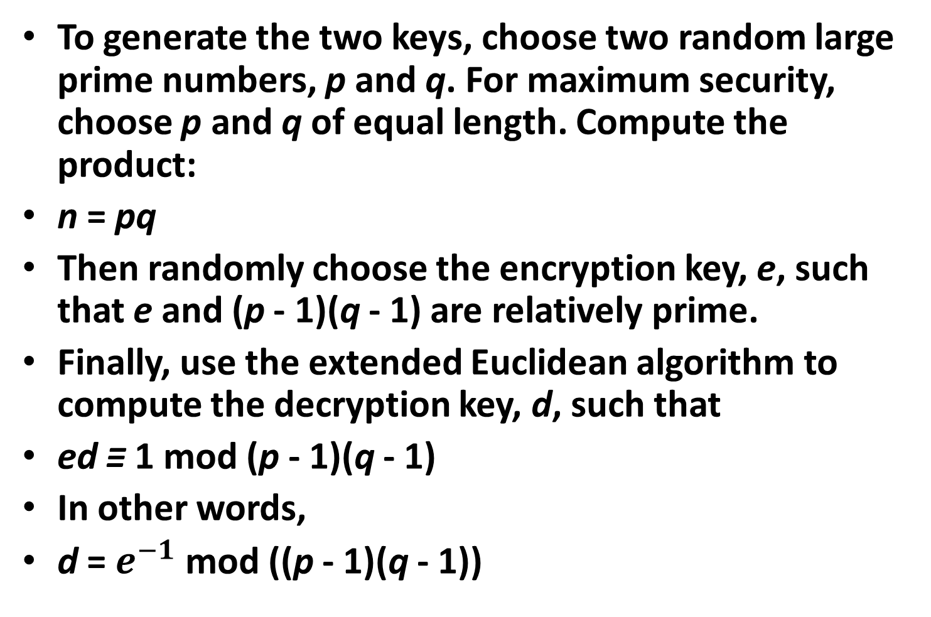
To generate the two keys, choose two random large prime numbers, p and q. For maximum security, choose p and q of equal length. Compute the product:
n = pq
Then randomly choose the encryption key, e, such that e and (p - 1)(q - 1) are relatively prime.
Finally, use the extended Euclidean algorithm to compute the decryption key, d, such that
ed ≡ 1 mod (p - 1)(q - 1)
In other words,
d = $e^{−1}$ mod ((p - 1)(q - 1))

Slide 5
Note that d and n are also relatively prime. The numbers e and n are the public key; the number d is the private key.
The two primes, p and q, are no longer needed. They should be discarded, but never revealed.
To encrypt a message m, first divide it into numerical blocks smaller than n (with binary data, choose the largest power of 2 less than n).
That is, if both p and q are 100-digit primes, then n will have just under 200 digits and each message block, mi , should be just under 200 digits long.

Slide 6
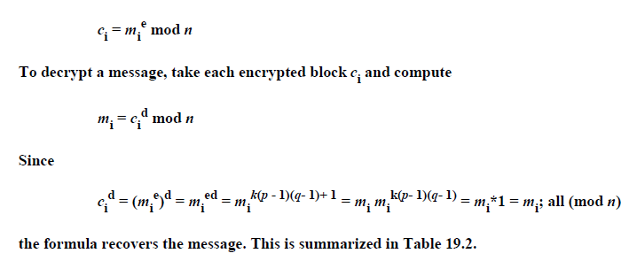
(If you need to encrypt a fixed number of blocks, you can pad them with a few zeros on the left to ensure that they will always be less than n.)
The encrypted message, c, will be made up of similarly sized message blocks, ci, of about the same length. The encryption formula is simply

Slide 7
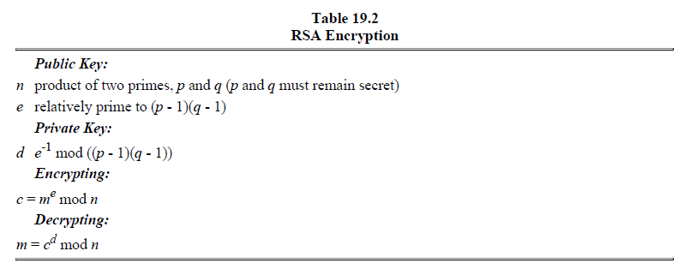

Slide 8
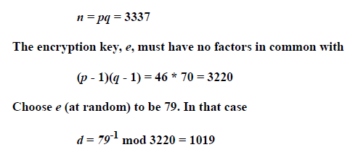
A short example will probably go a long way to making this clearer. If p = 47 and q = 71, then

Slide 9
This number was calculated using the extended Euclidean algorithm (see Section 11.3). Publish e and n, and keep d secret. Discard p and q. To encrypt the message
m = 6882326879666683
first break it into small blocks. Three-digit blocks work nicely in this case. The message is split into six blocks, mi, in which
m1 = 688
m2 = 232
m3 = 687
m4 = 966
m5 = 668
m6 = 003
The first block is encrypted as

Slide 10
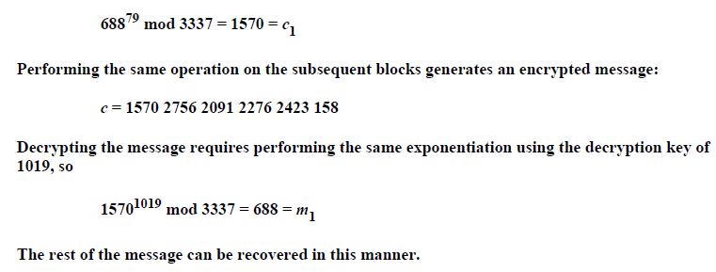

Slide 11
Security of RSA
The security of RSA depends wholly on the problem of factoring large numbers.
Technically, that’s a lie. It is conjectured that the security of RSA depends on the problem of factoring large numbers. It
has never been mathematically proven that you need to factor n to calculate m from c and e.
It is conceivable that an entirely different way to cryptanalyze RSA might be discovered.
However, if this new way allows the cryptanalyst to deduce d, it could also be used as a new way to factor large numbers.
It is also possible to attack RSA by guessing the value of (p - 1)(q - 1). This attack is no easier than factoring n

Slide 12
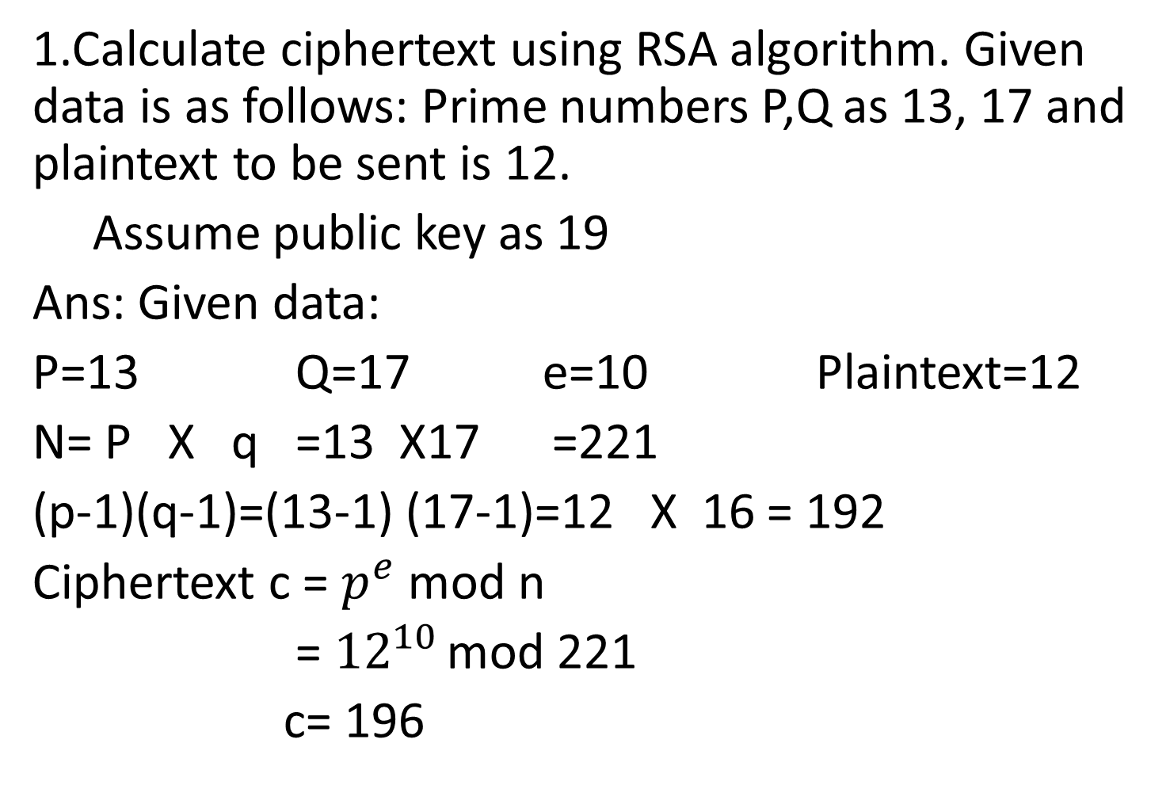
Examples:
1.Calculate ciphertext using RSA algorithm. Given data is as follows: Prime numbers P,Q as 13, 17 and plaintext to be sent is 12.
Assume public key as 19
Ans: Given data:
P=13 Q=17 e=10 Plaintext=12
N= P X q =13 X17 =221
(p-1)(q-1)=(13-1) (17-1)=12 X 16 = 192
Ciphertext c = $p^{e}$ mod n
= ${12}^{10 }$mod 221
c= 196

Slide 13
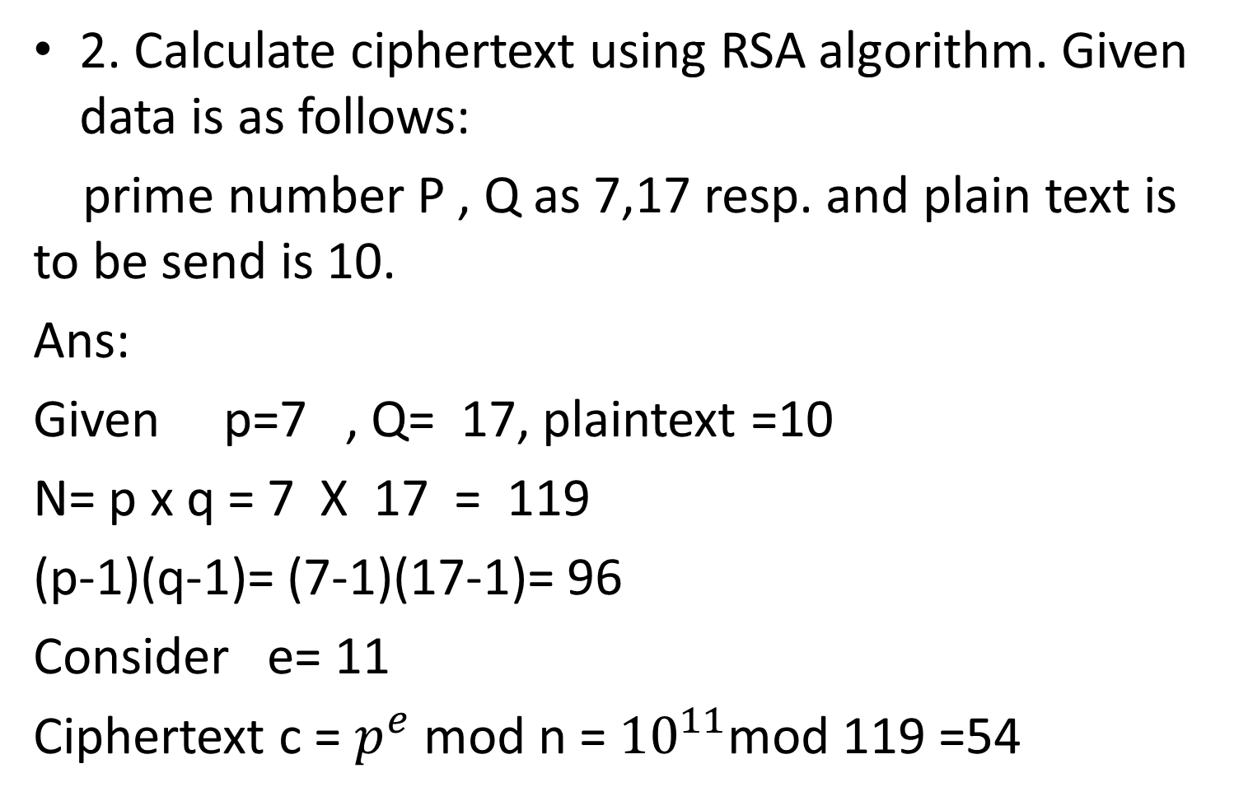
2. Calculate ciphertext using RSA algorithm. Given data is as follows:
prime number P , Q as 7,17 resp. and plain text is to be send is 10.
Ans:
Given p=7 , Q= 17, plaintext =10
N= p x q = 7 X 17 = 119
(p-1)(q-1)= (7-1)(17-1)= 96
Consider e= 11
Ciphertext c = $p^{e}$ mod n = ${10}^{11}$mod 119 =54

Slide 14
3. In a public key cryptosystem using RSA you intercept the cipher text C=284 sent to user whose public key is e=223 and n=713. What is the plain text M?

